Slide 1
Hating Emptiness

Slide 2
If you would like to watch the video of this live service, click here:
https://campaignkerusso.org/?p=15257
We would love to know more about the people who download our lessons & sermons. We invite you to email us & let us know where & how you use them.
info@ckusa.org

Slide 3
LESSON OUTLINE
Theme:
By rejecting God, we unwittingly set ourselves on a path of self-destruction.
Title:
Hating Emptiness
Text:
“Since they did not know the righteousness of God and sought to establish their own, they did not submit to God’s righteousness.” Rom. 10:3 NIV
Intro:
The “Candle & Rising Water” Experiment & Pascal’s quote.
We rejected our loving creator in order to take control of our own lives.
We try to control our lives, but we can’t.
We end up in an empty wasteland.
Like Solomon, we try unsuccessfully to fill our lives with other things.
Actually, we are not very good at controlling our lives. Therefore, we yield some control back to other people & programs.
We become the prisoners of the very things we invite to replace God in our lives.
It’s a downhill slide.
Conclusion:
What will be your master? Will it be sin—which will lead to certain death—or obedience—which will lead to a right and reconciled life?

Slide 4
SO DO PEOPLE

Slide 5
Intro:
The “Candle & Rising Water” Experiment and Pascal’s quote.

Slide 6
What happens in a vacuum?
Light the candle and place it on a dish with water.
Cover the candle with an upside-down glass.
When the candle goes out, the air will cool and contract .
Water will start rising inside the glass to fill the vacuum.

Slide 7
Lighted Candle in Dish

Slide 8
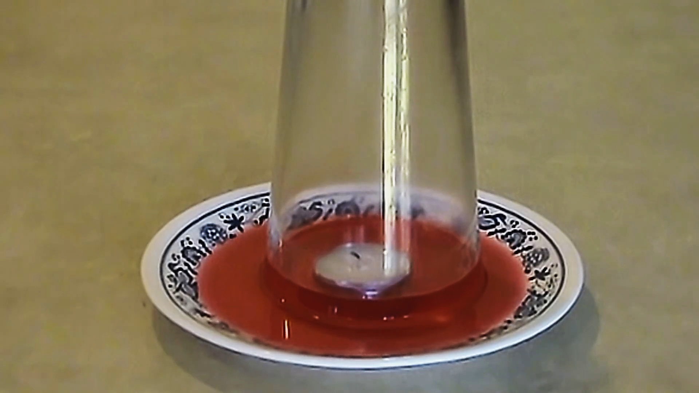
Candle Covered with Upside-down Glass

Slide 9
Candle Covered with Upside-down Glass

Slide 10
Candle Flame Dies, Water Rises into Glass

Slide 11
Suggested Next Slide - Video:
Fire and Water Magic Trick
Click or Ctrl Click Here:
https://youtu.be/hd7vbYzodoo

Slide 12
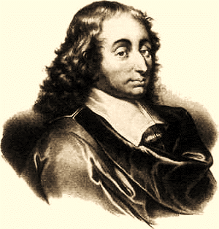
A scientist named Blaise Pascal, who lived in Paris in the 1600’s, was one of the first to artificially create a vacuum inside a glass tube, thus proving that vacuums can exist.
Today, a unit of vacuum measure is called a “Pascal.”
Blaise Pascal (1623–1665)

Slide 13
“There is a God-shaped vacuum inside the heart of every man, which cannot be filled by any created thing,
but only by God the Creator, made known through Jesus Christ.”

Slide 14
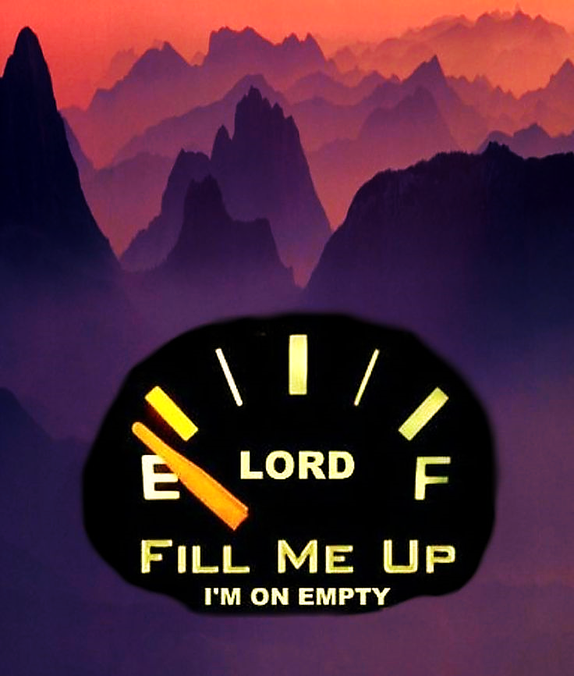
Without God, we are running on empty.

Slide 15
“Jerusalem, Jerusalem, the city that kills the prophets and stones those sent to her! How often I have wanted to gather your children together, as a hen gathers her chicks under her wings, but you were not willing!” …

Slide 16
…As a hen protects and cares for her chicks, we were meant to be under the loving care, and in close relationship, to our own Creator—God !!” Mat. 23:37 GW

Slide 17
God is our life source—
He is, to us, like oxygen is to that candle flame.
We want to take control but lose the life sustaining protection only God (like oxygen) can provide.
Our life has become a vacuum.

Slide 18
1) We reject our loving creator in order to take control of our own lives.

Slide 19
We hate being
Under someone’s thumb

Slide 20
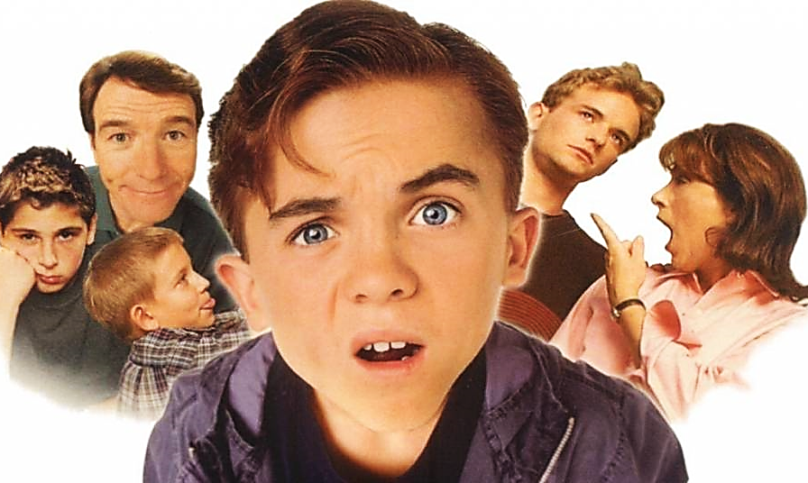
Who remembers the theme song to TV’s “Malcolm in the Middle?”
“You’re Not the Boss of Me
(and you’re not so big).”

Slide 21
Suggested Next Slide - Video:
You’re Not the Boss of Me
Click or Ctrl Click Here:
https://youtu.be/KEHq10rJAqc

Slide 22
We’ve all said or thought it.

Slide 23
Employees & Bosses

Slide 24
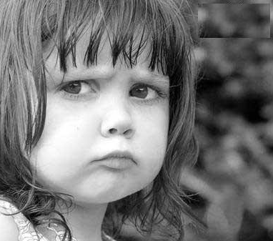
Children & Parents

Slide 25
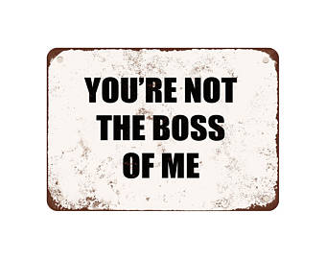
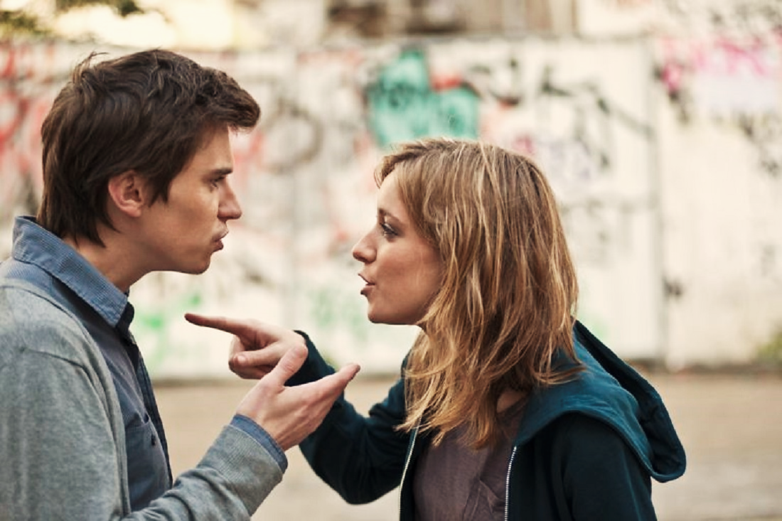
Husbands & Wives

Slide 27
2) We try to control our own lives

Slide 29
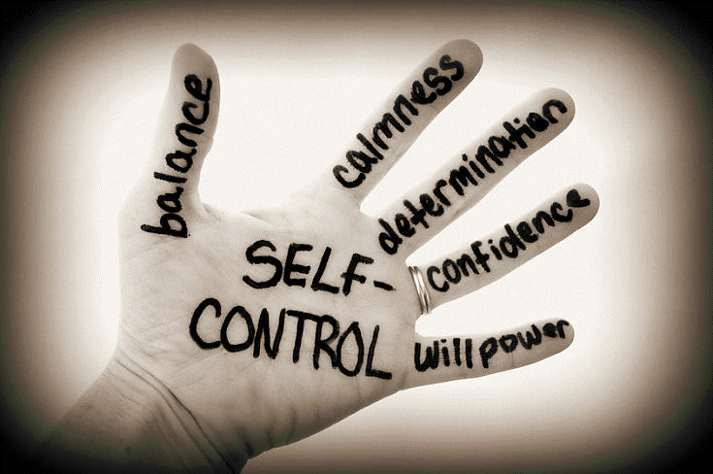
We even try to control ourselves.
“Since they did not know the righteousness of God and sought to establish their own, they did not submit to God’s righteousness.” Rom. 10:3 NIV

Slide 30
There’s even a magazine for it!

Slide 31
Yet even its publishers had little control over life of their publication.
Ironically, their magazine never even made it to its twelfth issue!

Slide 32
3) We end up in an empty wasteland.

Slide 33
“The rebellious dwell in a dry land” Ps. 68:6 KJV

Slide 34
We abhor our own sense of dissatisfaction and lacking in our own life, just like nature abhors a vacuum.
Adam and Eve were foolishly distracted by the devil (from trusting God’s provision) & ended up wondering outside of paradise.
Cain rejected God plan, killed his brother & ended up a lonely world wanderer.
Israel failed to enter their Promised Land & ended up wandering in the wilderness for the next 40 years.

Slide 35
Just as nature struggles to fill a vacuum, we struggle to fill the deep secret vacuum & emptiness of our lives.

Slide 36
4) Like Solomon we try unsuccessfully to fill our lives with other things.

Slide 37
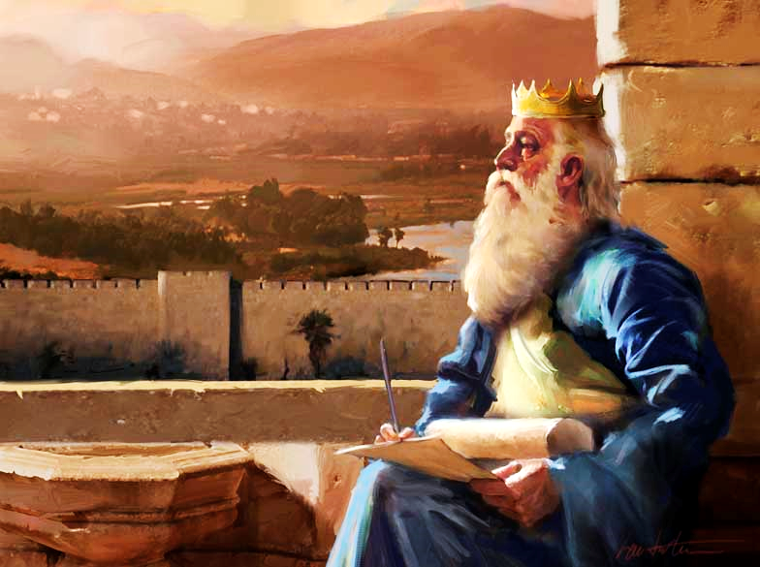
Solomon Expessed People’s Sense of Hopelessness
“What do people get for all their hard work under the sun? Generations come and generations go, but the earth never changes.
The sun rises and the sun sets, then hurries around to rise again.
The wind blows south, and then turns north. Around and around it goes, blowing in circles.” Eccl. 1:3-6 NLT

Slide 38
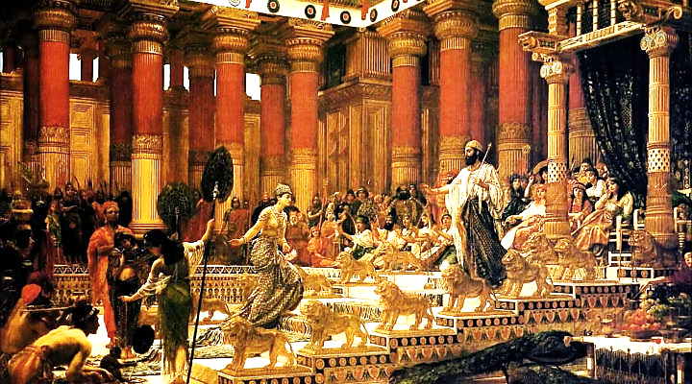
Some Search through Pleasure
“I said to myself, “Come on, let’s try pleasure. Let’s look for the ‘good things’ in life.” But I found that this, too, was meaningless.” Eccl. 2:1 NLT

Slide 39
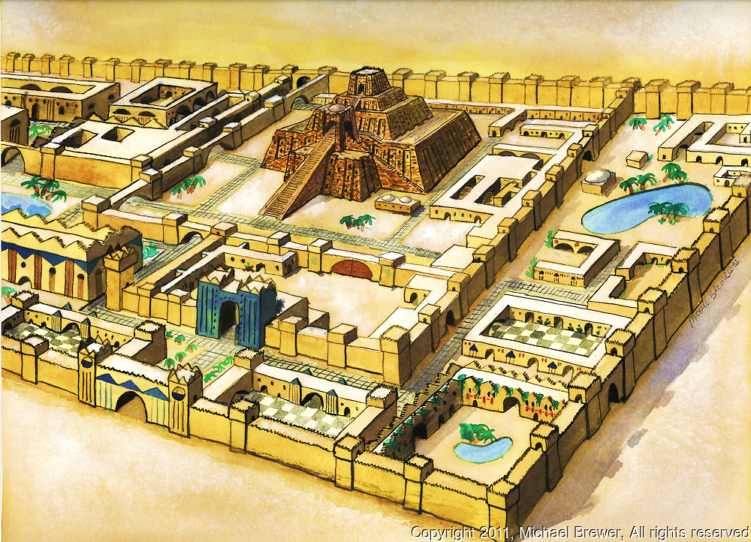
Some Search through Riches
“I also tried to find meaning by building huge homes for myself and by planting beautiful vineyards.
I made gardens and parks, filling them with all kinds of fruit trees.
I built reservoirs to collect the water to irrigate my many flourishing groves.”
Eccl. 2:4-6 NLT

Slide 40
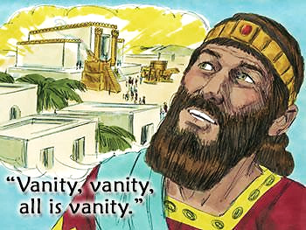
Solomon’s Conclusion:
All his work added up to nothing!
He concluded that, in his quest for real fulfillment, all his human efforts amounted to nothing & his attempts at
self- fulfillment
brought NO fulfillment.

Slide 41
Suggested Next Slide - Song:
All is Vanity
Click or Ctrl Click Here:
https://youtu.be/nOJz8SZR9PM

Slide 42
Johnny Lee’s “Lookin’ For Love In All the Wrong Places”
“Don't know where it started or where it might end; I turned to a stranger just like a friend.
I was lookin' for love in all the wrong places.
Lookin' for love in too many faces, searchin' their eyes and lookin’ for traces of what I'm dreamin' of.”

Slide 43
5) Solomon’s search for happiness often meant yielding control over to something else to fill that emptiness he felt.

Slide 44
Like him, we end up giving control over to anything that will fill our spiritual vacuum, like those chicks with no hen to care for them.

Slide 45
Slowly, we lose the very control we so badly wanted by handing it over to anything or anyone that might fill the emptiness we feel.
Every computer keyboard has one of these keys and how it works is a lesson for us all.

Slide 46
The Control key does nothing by itself.
The Control key is a lonely key. It only works when pressed together with one of several another keys.
It’s that other key that’s really in control.

Slide 47
We are like that Control key. We have no real control all by ourselves.
We need help, so we yield our control over to other things we have added to our lives.

Slide 48
Do we ever really “get control” over our lives?
Ironically, in order to gain more control, we actually yield control of some part of ourselves: to a program, person or thing, that promises to…
…fill the vacuum in our lives.

Slide 49
For example, if we are overweight, we yield control to a weight loss plan.

Slide 50
If we feel insecure, we yield control to a “self-improvement” program.

Slide 51
If we think money will buy happiness, we might yield control to weekly lottery tickets.

Slide 52
What’s really in control of your life?

Slide 53
We become enslaved to the worldly things we have sucked into our lives to try and fill the empty vacuum left behind when we evicted God.

Slide 54
The problem is.
In seeking freedom, we actually lose it.
“Jesus answered them, `I tell you the truth. People who do wrong things are not free. They become a slave of the wrong things they do.” (WE)

Slide 55
7) It’s a downhill slide.

Slide 56
The downhill slide, as we see it
We are rebels from childhood.
We rebel to gain control of our own lives
We want control because something is missing
To gain control, we must yield control

Slide 57
The downhill slide, as we see it
We are rebels from childhood.
We rebel to gain control of our own lives.
We want control because something is missing
To gain control, we must yield control

Slide 58
The downhill slide, as we see it
We are rebels from childhood.
We rebel to gain control of our own lives.
We want control because something is missing.
To gain control, we must yield control

Slide 59
The downhill slide, as we see it
We are rebels from childhood.
We rebel to gain control of our own lives.
We want control because something is missing.
To gain control, we must yield control.

Slide 60
The downhill slide, as God sees it
We are rebels since the Garden of Eden.
We are left wandering in a spiritual vacuum
We try to regain control on our own
We end up yielding to things that can’t satisfy

Slide 61
The downhill slide, as God sees it
We are rebels since the Garden of Eden.
We are left wandering in a spiritual vacuum.
We try to regain control on our own
We end up yielding to things that can’t satisfy

Slide 62
The downhill slide, as God sees it
We are rebels since the Garden of Eden.
We are left wandering in a spiritual vacuum.
We try to regain control on our own.
We end up yielding to things that can’t satisfy

Slide 63
The downhill slide, as God sees it
We are rebels since the Garden of Eden.
We are left wandering in a spiritual vacuum.
We try to regain control on our own.
We end up yielding to things that can’t satisfy.

Slide 64
Remember Pascal, who spoke of the vacuum in our heart?
He also said this: “Diversions prevent us from acknowledging our essential misery.
They create a false sense of security that hides the abyss or vacuum within.”
Life’s diversions become our masters.

Slide 65
The Bible says:
“Doesn’t it make sense that if you sign yourself over as a slave, you will have to obey your master?”
Rom. 6:16 (Voice)
The question before you is:
What will be your master?
Will it be sin—or obedience?
Which will lead to a right and reconciled life?

Slide 66
Suggested Next Slide - Song:
“Control”
Click or Ctrl Click Here:
https://youtu.be/kFfztu8-bBQ

Slide 67
Is Jesus
Speaking to You?
“They said to each other, ‘Did not our hearts burn within us while he talked to us on the road, while he opened to us the Scriptures?’”
John Wesley Said:
“…the preacher was describing the change which God works in the heart through faith in Christ and I felt my heart strangely warmed.”
Jesus makes His presence Known by a small voice!

Slide 69
What is the Sinner‘s Prayer?
This is a prayer we can pray when we are ready to admit we are sinners and need Christ’s forgiveness.
It must be prayed with faith in our hearts and a readiness to have a life-changing encounter with Jesus Christ.

Slide 70
“Draw near to God, and He will draw near to you…
…Cleanse your hands, you sinners, and make your hearts pure, you who are half-hearted towards God.” James 4:8 WNT

Slide 71
A prayer of faith → Pray this prayer if :
If you never have before
You have in the past, but you think it would mean more today
You have been walking afar off and you want to come back
You want to set an example & show others how it is done
You just like to give your heart to Jesus again & again
Faith

Slide 72
Dear Jesus,
I know I am a sinner & need your forgiveness.
I believe you died for my sins.
I now turn from sin.
Come into my heart I pray.
Please wash away my sin.
Do you want to meet Jesus as your savior right now?
Do you believe He died to save you from your sins & that He rose from the dead?
Do you believe that He is waiting to save you right now?

Slide 73
“But some people did accept him. They believed in him, and he gave them the right to become children of God.”
John 1:12

Slide 75
We Declare Our Faith Publicly Because Jesus Declared His LOVE Publicly
“If you stand before others and are willing to say you believe in me, then I will tell my Father in heaven that you belong to me.” Mat 10:32

Slide 76
“If you openly say, ‘Jesus is Lord’ and believe in your heart that God raised him from death, you will be saved.”
Rom. 10:9
What did you learn today?
What have you been thinking about God lately?
What do you want to tell others about Jesus?

Slide 77
Close in Prayer

